Slide 1


How to Automate Common File-Based Tasks

Slide 2

Who Am I
Adam Bertram
17 Year IT Veteran
Microsoft MVP (PowerShell)
Blogger: adamtheautomator.com
Technology Writer
Twitter: @adbertram
02

Slide 3
Moving Files Around Isn't Hard
What's so hard?
I already know how to move files
03

Slide 4
Life Isn't as Easy as I Thought
04

Slide 5

Why Automate File-Based Tasks?
...but it doesn't take that long
Free up time
Big money!
05

Slide 6
File-Based Tasks: What Does that Mean?
Tasks that move files around
Typically routine tasks
06

Slide 7
How to Automate File-Based Tasks: Scripts
Let me Help You
No Support
07

Slide 8
Commonly Overlooked Issues with Scripts
LOG
Good Scripts Require A Lot of Planning
Environment
Changes
Error
Handling
Logging
08

Slide 9
How to Automate File-Based Tasks: MoveIt Central
Two Different Ways to Get There
Time is Money
Software Saves Time
09

Slide 10
The Scenario: Secure B2B File Transfer
What We're Doing
10

Slide 11
4 Steps to Achieving the Goal
1
2
3
4
Monitoring a Folder
Making Changes to the Folder
Encrypting Files
Moving Files
11

Slide 12
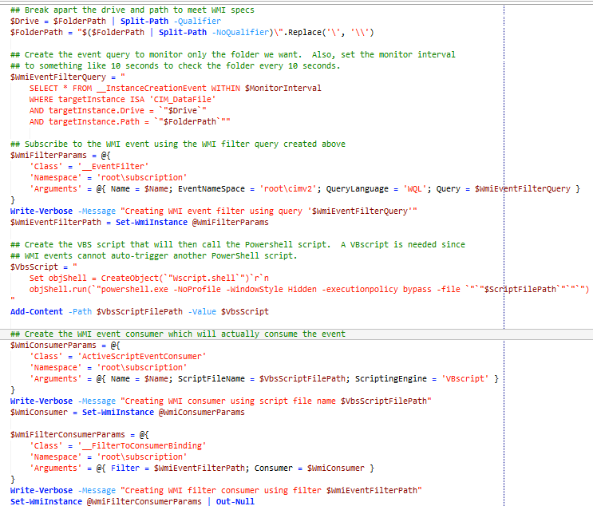
Step #1: Monitoring a Folder
WMI Events
Script Breakdown
Code Length can be Deceiving
12

Slide 13
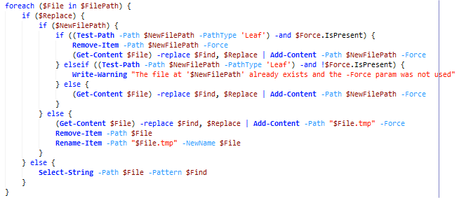
Step #2: Making Changes to Files
Use Get/Add-Content
Script Breakdown
13

Slide 14
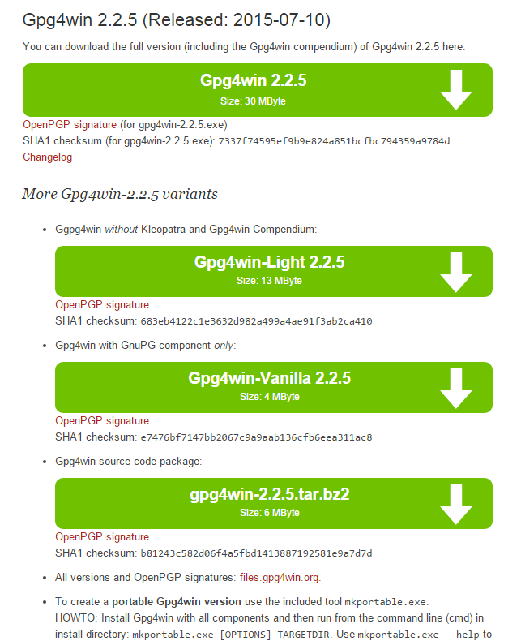
Step #3: Encrypting Files - Installing GnuPG
14

Slide 15
Step #3: Encrypting Files - Writing the Script
Cleartext Passwords = Bad
Big Learning Curve
15

Slide 16
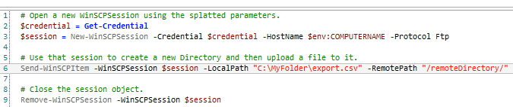
Step #4: Moving files
WinSCP
Sometimes You'll Get Lucky
16

Slide 17
Final Script Thoughts
Some scripts are Hard!
Scripts Can Solve Lots of Problems
17

Slide 18
Comparing Scripts and MoveIT Central
 | Scripts | MoveIT Central
Ease of Use | Red | Green
Reliability | Yellow | Green
Price | Green | Yellow
Flexibility | Green | Green
Time | Red | Green
18

Slide 19


MoveIT Central and PowerShell as a Team
18

Slide 20
Questions?
Thank You for Your Attention!

